Slide 1
Responses of animals to the biotic environment
Interspecific aggressive responses:
Predators
Hunt and kill other animals for food

Slide 2
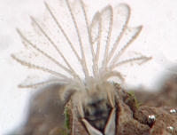
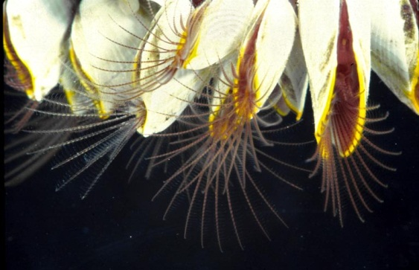
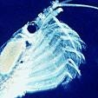
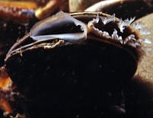
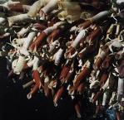
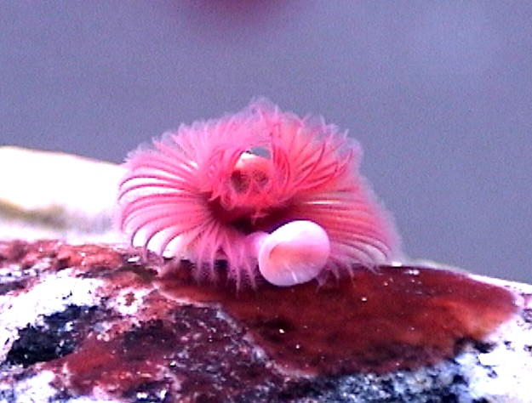
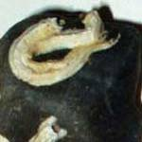
Adaptations for getting food
Predators who let the prey come to them
  Filter feeders sift the environment
Mussel
Acorn Barnacle
Goose-neck Barnacle
Krill
Deep sea tube worms
More tube worms

Slide 3
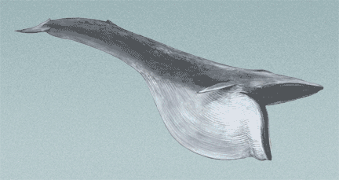
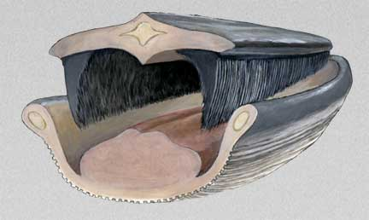
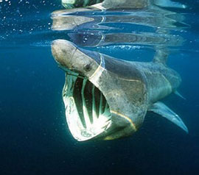
Filter feeders (cont’d)
The biggest filter feeders of them all.
Baleen whales
Basking sharks

Slide 4
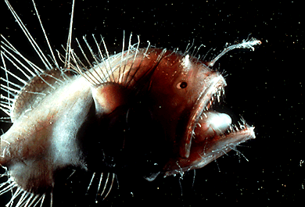
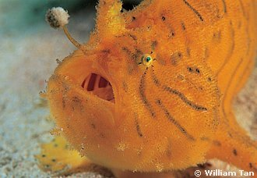
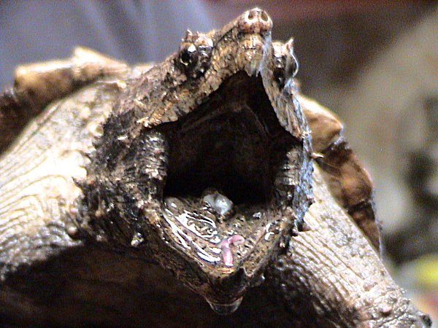
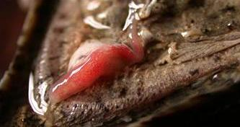
Predators who dangle baits
Angler fish
Snapping turtle

Slide 5
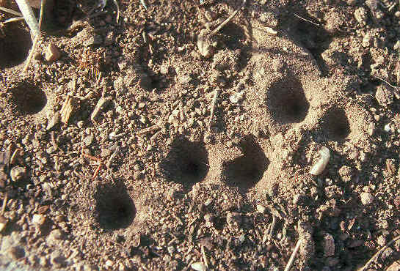
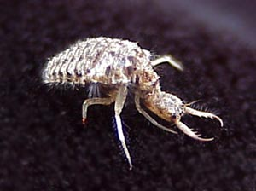
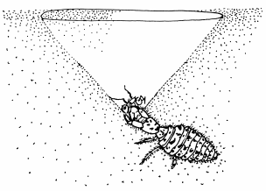
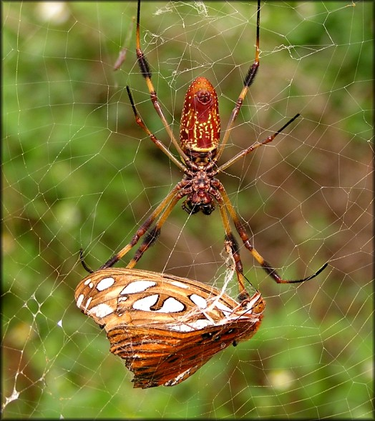
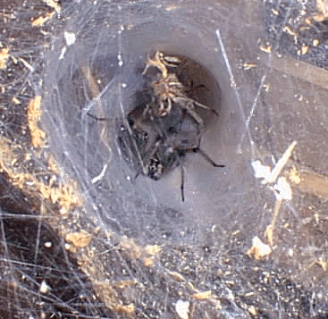
Predators who use traps
Ant lion pits Ant lion
Golden orb web spider
Funnel web spider

Slide 6
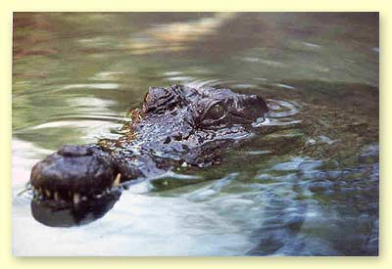
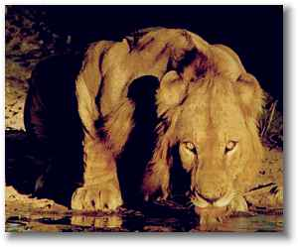
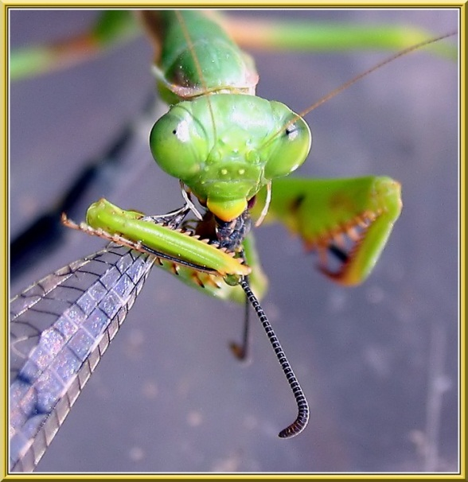
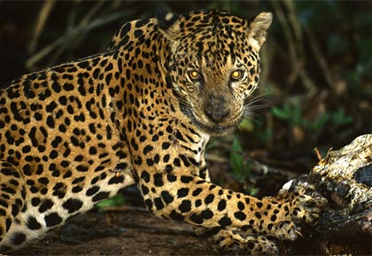
Predators who ambush their prey

Slide 7
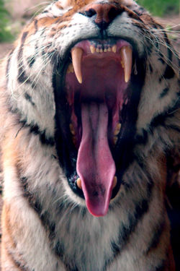
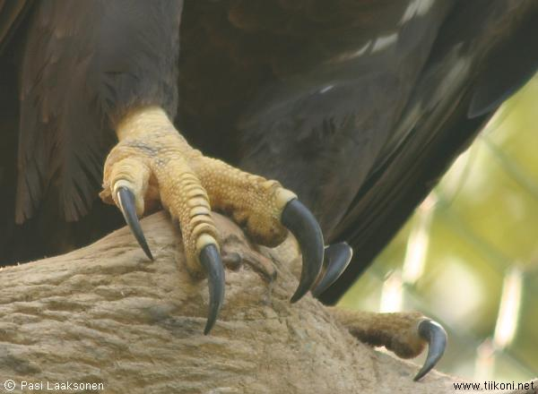
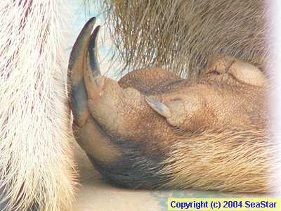

Predators must have the right appendages
Teeth, claws, tongues

Slide 8
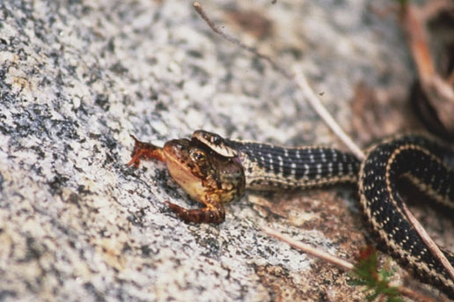
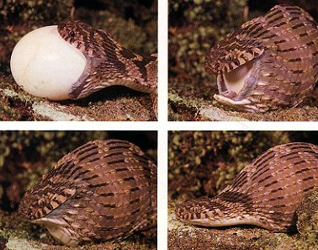
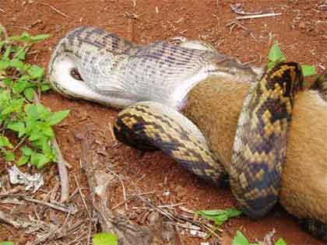
More Predator appendages
Snakes’ jaws can disengage so they can swallow their prey, be it an egg, a frog or a kangaroo!
  Even an alligator

Slide 9
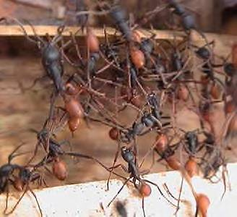
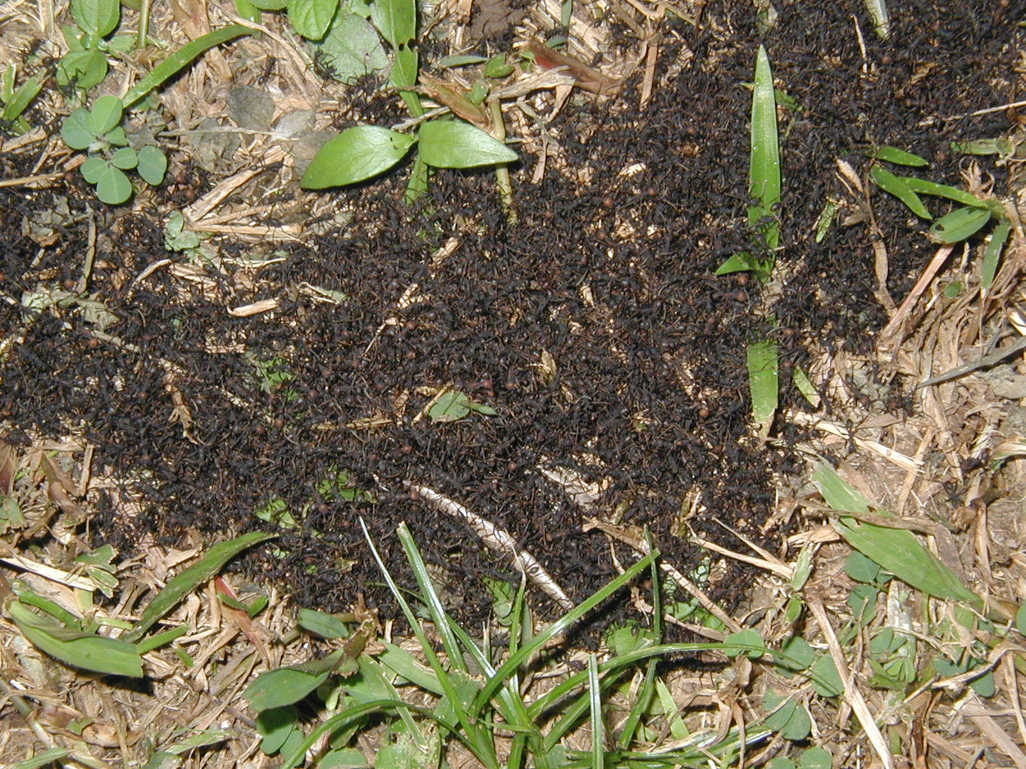
Some predators Hunt in swarms, e.g. army ants

Slide 10
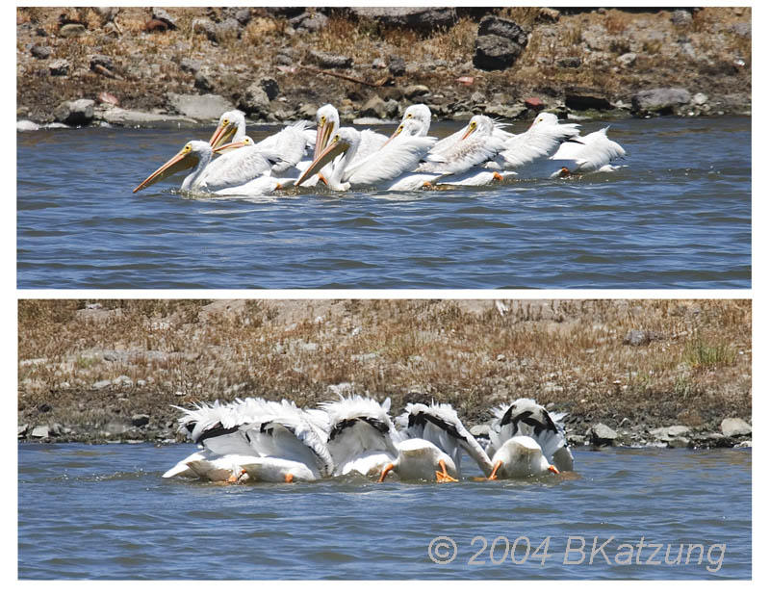
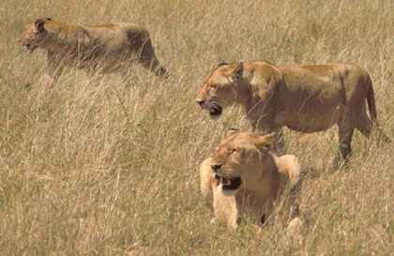
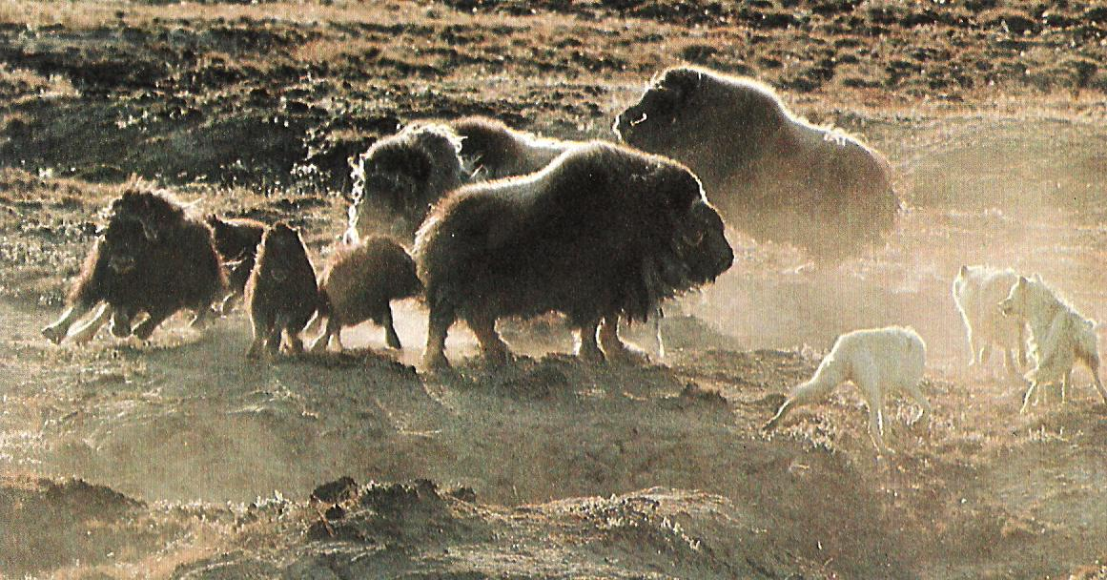
Some hunt in teams
Pelicans
Lions
Wolves

Slide 11
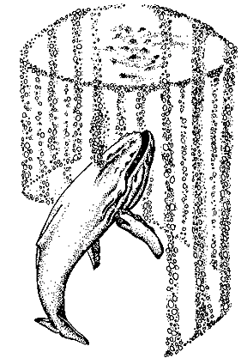
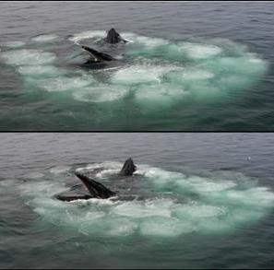
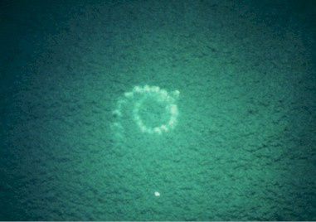
Humpback whales hunt in teams using bubble nets

Slide 12
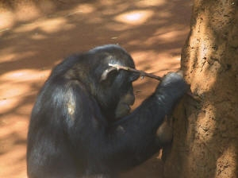
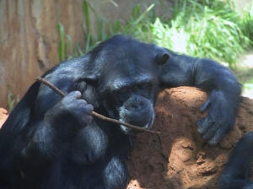
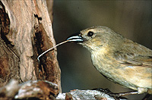
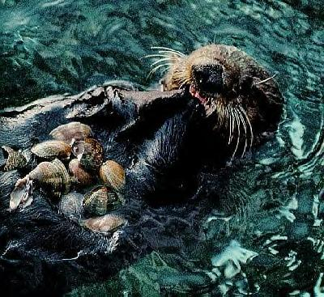
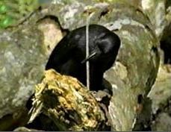
Some predators use tools
A chimp uses a stick to “fish” for termites
Darwin’s finches on the Galapagos islands, and crows on Numea use sticks or cactus spines to lever grubs out of their holes under bark.
A sea otter uses a stone as an anvil on which to break shells

Slide 13
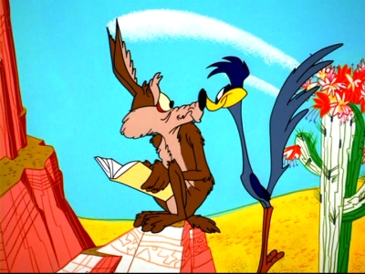
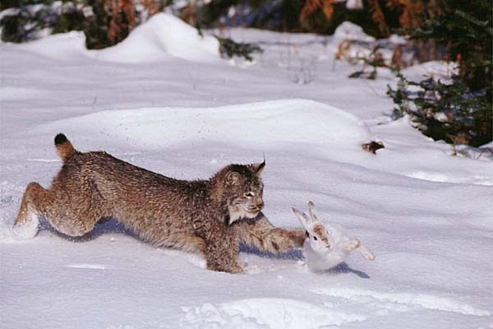
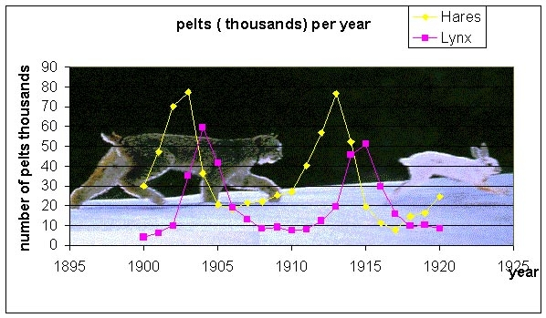
Predator- prey relations
Predators must establish a balance with their prey species. This can result in cyclic fluctuations in numbers.
Such a relationship was discovered between the lynx and its prey, the arctic hare.

Slide 14
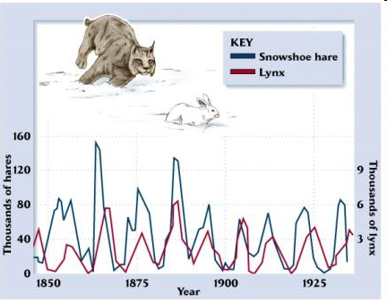

Slide 15
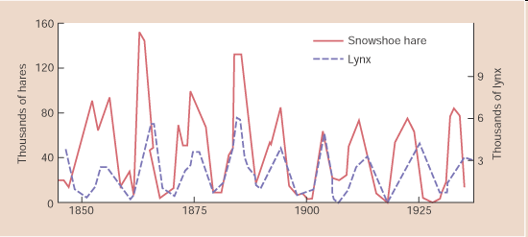
The hares rise in numbers followed by their predators, the lynx. This results in lowering of the prey (hares), which in turn results in reduction of lynx numbers as they run out of food. The hares can then increase again

Slide 16
